Slide 1
Oklahoma Enhanced Tier Payment System
The Enhanced Tier Payment System (ETPS) is an innovative payment structure developed to enhance the recovery outcomes of customers in the mental health and substance abuse system.
http://www.odmhsas.org/eda/etps/

Slide 2
Overview
Community Mental Health Centers (CMHCs) have the opportunity to earn money directly related to individual levels of performance on twelve measures.

Slide 3
Measures
Outpatient Crisis Service Follow-up within 8 Days
Inpatient/Crisis Unit Follow-up within 7 Days
Reduction in Drug Use
Engagement: Four Services within 45 Days of Admission
Medication Visit within 14 Days of Admission
Access to Treatment - Adults
Improvement in CAR (Client Assessment Record) Score: Interpersonal Domain
Improvement in CAR Score: Medical/Physical Domain
Improvement in CAR Score: Self Care/Basic Needs Domain
Inpatient/Crisis Unit Community Tenure of 180 Days
Peer Support: % of Clients Who Receive a Peer Support Service
Access to Treatment - Children

Slide 4
Current Data System - Oklahoma
Fee-for-service based payment
Provider submit DMH and Medicaid claims together
Demographic information collect at admission, discharge, level of care change and at treatment plan update (usually six months).
Information include age, race, sex, living situation, TEDS data elements, assessment scores, etc.

Slide 5
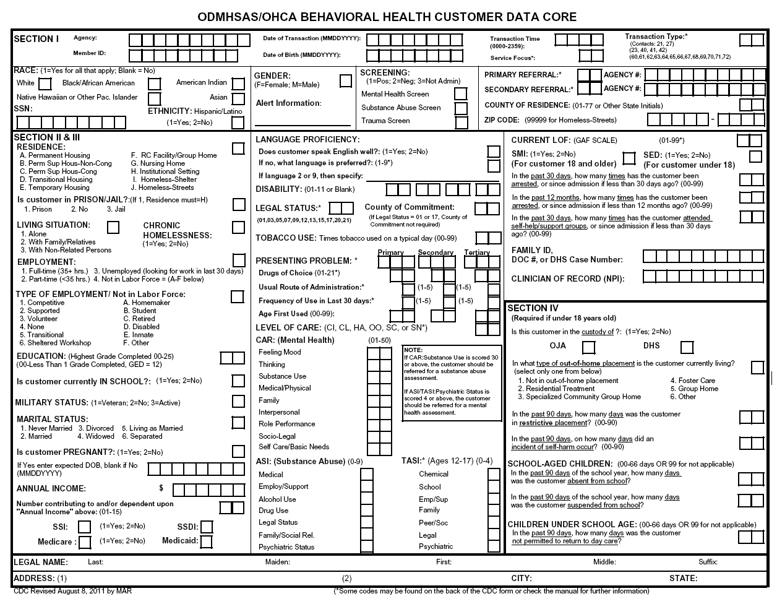
Terminology
CDC – Client Data Core (see example)

Slide 6
Oklahoma Community Mental Health Centers
14 CMHCs
4 State Operate
10 Private, Not for Provider
Each owns their own data system
Data submitted via FTP and/or Web service to central repositories
CDC to one location
Claims to another

Slide 7
Oklahoma CMHC Comparison
Name | Served per Month | Urban | State Operated | Rank Last Quarter
GRAND LAKE MENTAL HEALTH CENTER | 2,132 |  |  | 1
CREOKS MENTAL HEALTH | 1,786 |  |  | 2
HOPE COMMUNITY SVCS INC | 1,218 | ü |  | 3
NORTH CARE CENTER | 1,732 | ü |  | 4
CARL ALBERT CMHC | 879 |  | ü | 5
EDWIN FAIR CMHC | 626 |  |  | 6
GREEN COUNTRY MENTAL HLTH | 648 |  |  | 7
FAMILY & CHILDRENS SVCS | 3,597 | ü |  | 8
COUNSELING & RECOVERY SERVICES | 1,049 | ü |  | 9
RED ROCK CMHC | 2,308 | ü |  | 10
NORTHWEST CENTER FOR BEHAVIORAL HEALTH | 1,100 |  | ü | 11
CENTRAL OKLA CMHC | 1,025 | ü | ü | 12
MENTAL HLTH SVC SO OK | 1,382 |  |  | 13
JIM TALIAFERRO CMHC | 726 |  | ü | 14

Slide 8
Measure Identification
A high priority was improving access to care.
Measure should be based on current data.
Providers already submitted claims and periodic demographic data.
The only new measure that did not previously exist was the access to treatment measure.
This measure was based secret shopper approach conducted by state staff.

Slide 9
Building Consensus and Measure Transparency
ODMHSAS initially meet face-to-face with providers to discuss measures.
Both parties agreed on how measures were defined.
Additionally phone calls and webinars were provided to all provider staff.
Reports were made available so each provider could see summary results of other providers.
Reports also showed each provider their detailed information to the client level.
Multiple onsite trainings were/are provided by ODMHSAS staff to CMHC staff

Slide 10
Setting Benchmarks
Once all parties were in agreement to how measure were defined, the past six month (July 2008-December 2008) period was measure to set statewide averages.
From those measurements, upper and lower limits were based on one standard deviation from the average.

Slide 11
Benchmark (Inpatient Follow Up)
50%
100%

Slide 12
How much is each CMHC able to earn each quarter?
Based on the number of unduplicated clients served in the past four months
Agency X serves 1,000 person
Statewide, 15,000 persons are served
1,000 / 15,000 = 6.6% of all money

Slide 13
Example of earnings by quarter
Agency X served 6.6% of the clients
Amount available for all measures is $11,000,000
Amount available for each measure is $916,667
Agency Score in 100% Range, they earn:
6.6% * $916,667 = $60,500 per measure

Slide 14
How much money is there?
It varies from quarter to quarter.
1st Quarter FY16: $10,728,875
2nd Quarter FY16: $11,820,908
3rd Quarter FY16: $11,025,662
4th Quarter FY16: $11,071,700
FY16 Total = $44,647,145

Slide 15
Report Examples* - Summary of All Measures
*All report examples do not include the Adult and Child Access to Treatment measures.

Slide 16
Report Examples* - Summary By Agency
*All report examples do not include the Adult and Child Access to Treatment measures.

Slide 17
Report Examples* - Summary By Measure
*All report examples do not include the Adult and Child Access to Treatment measures.

Slide 18
Report Examples* - Detail Report - Original Benchmark Determination
*All report examples do not include the Adult and Child Access to Treatment measures.

Slide 19
Report Examples* - Detail Report - Current Scores
*All report examples do not include the Adult and Child Access to Treatment measures.

Slide 20
Report Examples* - Detail Report – Drill Down
*All report examples do not include the Adult and Child Access to Treatment measures.

Slide 21
Benchmarks
 | Benchmark %
Measure | Current | 7/1/2017
Engagement in Treatment within 45 Days | 45.3 | 58.9
Improvement in CAR Score Domain: Interpersonal | 24.8 | 32.6
Improvement in CAR Score Domain: Medical/Physical | 42.7 | 48.0
Improvement in CAR Score Domain: Self Care/Basic Needs | 39.4 | 47.0
Inpatient/Crisis Unit Follow-up within 7 Days | 53.5 | 66.7
Inpatient/Crisis Unit Community Tenure of 180 Days | 78.5 | 80.0
Medication Visit within 14 Days of Admission | 33.3 | 43.2
Outpatient Crisis Service Follow-up within 8 Days | 38.8 | 56.3
Outpatient Peer Recovery Support Services | 13.0 | 20.0
Reduction in Drug Use | 34.1 | 41.3

Slide 22
State Average - Change
 | Average
Measure | June 2009 | June 2016 | Change
Outpatient Crisis Service Follow-up within 8 Days | 29.8 | 83.8 | 54.0
Engagement in Treatment within 45 Days | 45.2 | 75.3 | 30.1
Outpatient Peer Recovery Support Services | 1.1 | 30.2 | 29.1
Inpatient/Crisis Unit Follow-up within 7 Days | 53.9 | 80.9 | 27.0
Improvement in CAR Score Domain: Interpersonal | 25.6 | 42.9 | 17.3
Medication Visit within 14 Days of Admission | 41.4 | 57.1 | 15.7
Improvement in CAR Score Domain: Self Care/Basic Needs | 40 | 54.9 | 14.9
Reduction in Drug Use | 36.7 | 49 | 12.3
Improvement in CAR Score Domain: Medical/Physical | 47.1 | 52.2 | 5.1
Inpatient/Crisis Unit Community Tenure of 180 Days | 73.2 | 77.4 | 4.2

Slide 23
Oklahoma ETPS Summary
What it did?
Improved access to services, follow up, engagement
Paid for what we agreed is important
Provider increased the number served
Jan 2009 = 23,500 / Jun 2016 = 32,280
37.3% increase in customers served from January 2009 through June 2016
Why it worked?
Consensus and transparency built in
Had data system to support process

Slide 24
Questions
Carrie Slatton-Hodges, Deputy Commissioner of Mental Health
Chodges@odmhsas.org
405-522-3878
Mark A. Reynolds, Senior Director of Decision Support Services
mareynolds@odmhsas.org
405-248-9216
Wendy Larsen, Director of Program Enhancement
wlarsen@odmhsas.org
405-522-6765
Please contact Mark if you would like to see a live demonstration of the system!

Slide 25
Additional Information
http://www.odmhsas.org/eda/etps/

Slide 26
Setting Benchmarks
Once all parties were in agreement to how measure were defined, the past six month period was measure to set statewide averages.
From those measurements, upper and lower limits were based on one standard deviation from the average.

Slide 27
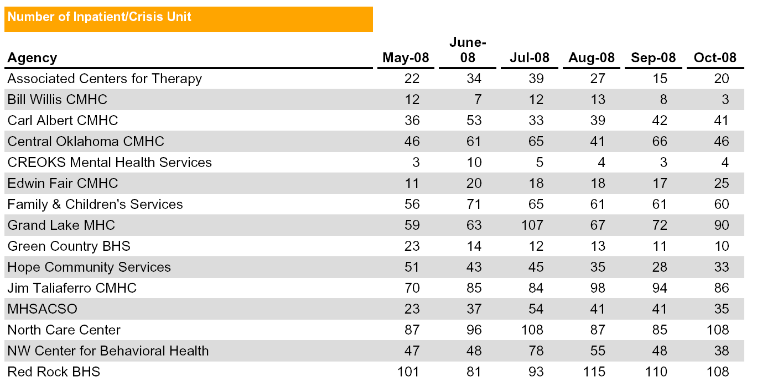
Denominator
Referrals

Slide 28
Numerator

Slide 29
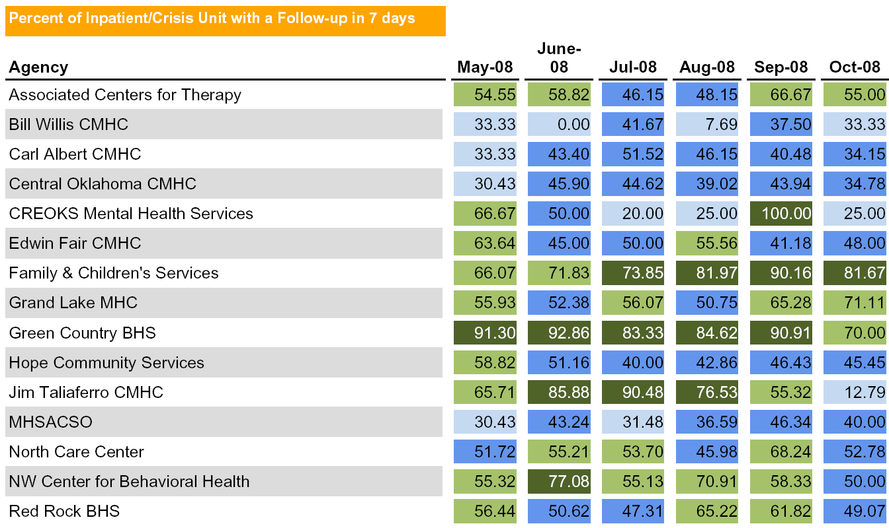
Scores

Slide 30
Benchmark
50%
100%

Slide 31
Measure #1: Outpatient Crisis Service Follow-up within 8 Days
Reflects the number, per month, of outpatient crisis service events that were followed-up by an outpatient non-crisis service within eight days.

Slide 32
Measure #1: Outpatient Crisis Service Follow-up within 8 Days
Results:
Agency Average (statewide standard = 38.8%):
Jul 2008 = 29.8%
Jan 2009 = 30.6%
Jun 2016 = 83.8%
Number of Agencies in the Bonus:
Jan 2009 = 4
Jun 2016 = 13

Slide 33
Outpatient Crisis Service Follow-up within 8 Days
Start of ETPS Process

Slide 34
Measure #2: Inpatient/Crisis Unit Follow-up within 7 Days
Reflects the number of inpatient/crisis service events that were followed-up by either outpatient or housing services within seven days of referral.

Slide 35
Measure #2: Inpatient/Crisis Unit Follow-up within 7 Days
Results:
Agency Average (statewide standard = 53.5%):
Jul 2008 = 53.9%
Jan 2009 = 58.2%
Jun 2016 = 80.9%
Number of Agencies in the Bonus:
Jan 2009 = 4
Jun 2016 = 11

Slide 36
Inpatient/Crisis Unit Follow-up within 7 Days
Start of ETPS Process

Slide 37
Measure #3: Reduction in Drug Use
Reflects the number of individuals who have reported a reduction in drug use over a seven month period.

Slide 38
Measure #3: Reduction in Drug Use
Results:
Agency Average (statewide standard = 34.1%):
Jul 2008 = 36.7%
Jan 2009 = 43.0%
Jun 2016 = 49.0%
Number of Agencies in the Bonus:
Jan 2009 = 4
Jun 2016 = 9

Slide 39
Reduction in Drug Use
Start of ETPS Process

Slide 40
Measure #4: Engagement: Four Services within 45 Days of Admission
Reflects the number of times a client received at least four services within 45 days of the start date of an outpatient episode.

Slide 41
Measure #4: Engagement: Four Services within 45 Days of Admission
Results:
Agency Average (statewide standard = 45.3%):
Jul 2008 = 45.2%
Jan 2009 = 42.9%
Jun 2016 = 75.3%
Number of Agencies in the Bonus:
Jan 2009 = 2
Jun 2016 = 13

Slide 42
Engagement: Four Services within 45 Days of Admission
Start of ETPS Process

Slide 43
Measure #5: Medication Visit within 14 Days of Admission
Reflects the number of times a medication visit occurred within 14 days of each admission.

Slide 44
Measure #5: Medication Visit within 14 Days of Admission
Results:
Agency Average (statewide standard = 33.3%):
Jul 2008 = 41.4%
Jan 2009 = 37.5%
Jun 2010 = 57.1%
Number of Agencies in the Bonus:
Jan 2009 = 2
Jun 2016 = 10

Slide 45
Medication Visit within 14 Days of Admission
Start of ETPS Process

Slide 46
Measure #6: Access to Treatment - Adults
Reflects the interval between initial contact and receipt of treatment services.
Bonus = See clinician for screening in 0-3 days
2 pts. = Come in within 4-5 days and will see clinician
1 pt. = Come in for paperwork 1-5 days, but won’t see clinician
0 pts. = Anything else

Slide 47
Measure #6: Access to Treatment - Adults
Results:
Number of Agencies in the Bonus:
Jan 2009 = 5
Jun 2016 = 13

Slide 48
Customer Count Changes
Results:
Number of customers served (DMH/TXIX):
Jan 2009 = 23,500
Jun 2016 = 32,280
37.3% increase in customers served from January 2009 through June 2016

Slide 49
Measure #7: Improvement in CAR Score: Interpersonal Domain
Reflects the number of individuals who have reported an improvement or reached a score of 20 on the CAR domain of Interpersonal over a seven month period.

Slide 50
Measure #7: Improvement in CAR Score: Interpersonal Domain
Results:
Agency Average (statewide standard = 24.8%):
Jun 2009 = 25.6%
Jun 2016 = 42.9%
Number of Agencies in the Bonus:
Jul 2009 = 4
Jun 2016 = 11

Slide 51
CAR Score Improvement: Interpersonal Domain
Start of ETPS Process

Slide 52
Measure #8: Improvement in CAR Score: Medical/Physical Domain
Results:
Agency Average (statewide standard = 42.7%):
Jun 2009 = 47.1%
Jun 2016 = 52.2%
Number of Agencies in the Bonus:
Jul 2009 = 5
Jun 2016 = 7

Slide 53
CAR Score Improvement: Medical/Physical Domain
Start of ETPS Process

Slide 54
Measure #9: Improvement in CAR Score: Self Care/Basic Needs Domain
Reflects the number of individuals who have reported an improvement or reached a score of 20 on the CAR domain of Self Care/Basic Needs over a seven month period.

Slide 55
Measure #9: Improvement in CAR Score: Self Care/Basic Needs Domain
Results:
Agency Average (statewide standard = 39.4%):
Jun 2009 = 40.0%
Jun 2016 = 54.9%
Number of Agencies in the Bonus:
Jul 2009 = 6
Jun 2016 =7

Slide 56
CAR Score Improvement: Self Care/Basic Needs Domain
Start of ETPS Process

Slide 57
Measure #10: Inpatient/Crisis Unit Community Tenure of 180 Days
Reflects the number of individuals who have NOT been readmitted to inpatient/CBSEC, after an inpatient/CBSEC discharge six months ago.

Slide 58
Measure #10: Inpatient/Crisis Unit Community Tenure of 180 Days
Results:
Agency Average (statewide standard = 78.5%):
Jun 2009 = 73.2%
Jun 2016 = 77.4%
Number of Agencies in the Bonus:
Jul 2009 = 1
Jun 2016 = 2

Slide 59
Inpatient/Crisis Unit Readmission within 180 Days
Start of ETPS Process

Slide 60
Measure #11: Peer Support: % of Clients Who Receive a Peer Support Service
Number of customers served divided by the number of customers who received one or more peer support services.

Slide 61
Measure #11: Peer Support: % of clients who receive a peer support service
Results:
Agency Average (statewide standard = 13%):
Jun 2009 = 1.1%
Jun 2016 = 30.2%
Number of Agencies in the Bonus:
Jul 2009 = 1
Jun 2016 = 13

Slide 62
Peer Support: % of clients who receive a peer support service
Start of ETPS Process

Slide 63
Measure #12: Access to Treatment - Children
Reflects the interval between initial contact and receipt of treatment services.
Bonus = See clinician for screening in 0-3 days
2 pts. = Come in within 4-5 days and will see clinician
1 pt. = Come in for paperwork 1-5 days, but won’t see clinician
0 pts. = Anything else

Slide 64
Measure #12: Access to Treatment - Children
Results:
Number of Agencies in the Bonus:
Oct 2009 = 8
Jun 2016 =13

Slide 65
Measures starting on 1/1/2009
Outpatient crisis service follow-up within 8 days
Inpatient/crisis unit follow-up within 7 days
Four services within 45 days of admission (engagement)
Medication visit within 14 days of admission
Reduction in drug use
Access to treatment (adults)

Slide 66
Measures starting on 7/1/2009
Improvement in CAR score: Interpersonal domain
Improvement in CAR score: Medical/physical domain
Improvement in CAR score: Self-care/basic needs domain
Inpatient/crisis unit community tenure of 180 days
Percent of clients who receive a peer support service
Access to treatment (children)

Slide 67
 | Benchmark % |  |  | Upper/Lower Limits*
Measure | Current | 7/1/2016 |  | Current | 7/1/2016
Engagement in Treatment within 45 Days | 45.3 | 58.9 |  | 14.4 | 11.7
Improvement in CAR Score Domain: Interpersonal | 24.8 | 32.6 |  | 11.8 | 7.7
Improvement in CAR Score Domain: Medical/Physical | 42.7 | 48.0 |  | 9.9 | 12.5
Improvement in CAR Score Domain: Self Care/Basic Needs | 39.4 | 47.0 |  | 15.1 | 8.7
Inpatient/Crisis Unit Follow-up within 7 Days | 53.5 | 66.7 |  | 19.4 | 12.9
Inpatient/Crisis Unit Readmission within 6 Months | 78.5 | 80.0 |  | 9.4 | 10.2
Medication Visit within 14 Days of Admission | 33.3 | 43.2 |  | 22.0 | 16.6
Outpatient Crisis Service Follow-up within 8 Days | 38.8 | 56.3 |  | 17.7 | 24.3
Outpatient Peer Recovery Support Services | 13.0 | 20.0 |  | 1.0 | 14.8
Reduction in Drug Use | 34.1 | 41.3 |  | 13.5 | 11.0
*One Standard Deviation

