Slide 1
MANAGING NARCISSISTIC, BORDERLINE AND ANTISOCIAL PERSONALITY DISORDERS (DSM-5)
Cardwell C. Nuckols, PhD
cnuckols@elitecorp1.com
www.cnuckols.com

Slide 2
ALTERNATIVE DSM-5 MODEL FOR PERSONALITY DISORDERS
Antisocial Personality Disorder
Avoidant Personality Disorder
Borderline Personality Disorder
Narcissistic Personality Disorder
Obsessive-Compulsive Personality Disorder
Schizotypal Personality Disorder

Slide 3
ALTERNATIVE DSM-5 MODEL FOR PERSONALITY DISORDERS
In this model personality disorders are characterized by impairments in personality functioning and pathological personality traits
In the Alternative Model for Personality Disorders histrionic and schizoid personality disorders are excluded
In the Alternative Model Criterion A: Level of Personality Functioning and Criterion B: Pathological Personality Traits make up the diagnostic model

Slide 4
ALTERNATIVE DSM-5 MODEL FOR PERSONALITY DISORDERS
Criterion A:Level of Personality Functioning
SELF:
Identity: Clear boundaries, stability of self-esteem and accuracy of self-appraisal, good emotional range
Self-direction: Coherent and meaningful short-term and life goals, prosocial internal standards of behavior, ability to self-reflect

Slide 5
ALTERNATIVE DSM-5 MODEL FOR PERSONALITY DISORDERS
Criterion A:Level of Personality Functioning
INTERPERSONAL:
Empathy: Appreciation of others experiences and motivations, tolerance for different perspectives, understanding the effects of one’s behavior on others
Intimacy: of connection with others, desire and capacity for closeness, mutuality of regard reflected in interpersonal behavior

Slide 6
ALTERNATIVE DSM-5 MODEL FOR PERSONALITY DISORDERS
Criterion B: Pathological Personality Domains
NEGATIVE AFFECTIVITY vs. EMOTIONAL STABILITY
DETACHMENT vs. EXTRAVERSION
ANTAGONISM vs. AGREEABLENESS
DISINHIBITION vs. CONSCIENTIOUSNESS
PSYCHOTICISM vs. LUCIDITY

Slide 7
ALTERNATIVE DSM-5 MODEL FOR PERSONALITY DISORDERS
Each personality domain has numerous traits
Example: Negative Affectivity vs. Emotional Stability
Emotional lability
Anxiousness
Separation insecurity
Submissiveness
Hostility
Perseveration

Slide 8
Personality Disorders
Totality of emotional and behavioral traits
Onset teens
Enduring, inflexible, consistent, and maladaptive
Causes significant impairment and/or distress
Traits vs. Disorder

Slide 9
Psychobiological Model of Personality
Personality (Cloninger, 1993)
Temperament-50% heavily influenced by genetics
Affective Tone
Intensity and Reactivity
Character-50% heavily influenced by environment
Moral and Value System

Slide 10
Psychobiological Model of Personality
Temperament
Novelty-Seeking
Harm-Avoidance
Reward-Dependence
Persistence
Character
Self-Directedness (Responsible, Purposeful & Resourceful)
Cooperativeness
Self-Transcendence
Altruism

Slide 11
Psychobiological Model of Personality
Genetics
Example-Antisocial Personality Disorder
Increased Impulsivity
Decreased Empathy
Low Frustration Tolerance
High Drive
High Sensation Seeking

Slide 12
Treatment Considerations
Relationship to Axis I
Egosyntonic and Characterological
Character traits more amenable to treatment
Transference/Countertransference
Stress a variable in intensity

Slide 13
Treatment Considerations
Psychotherapeutic Treatment Strategies
Increase acceptance and tolerance
Reduce intensity of trait expression
Promote adaptive trait-based behavior
Create conducive environments

Slide 14
Psychotherapeutic Treatment Strategies
Increase acceptance and tolerance
Psycho-education
Identify adaptive features
Reduce intensity of trait expression
Restructure triggering situations
Modify amplifying cognitions
Enhance incompatible behaviors
Medication

Slide 15
Psychotherapeutic Treatment Strategies
Promote adaptive trait-based behavior
How and when to ask for help
Create conducive environments
Modify environment to match client instead of asking the client to adapt to the environment that has been problematic

Slide 16
Create Conducive Environment
Help them find an environment they can flourish in
Especially true with Borderline PD
Set appropriate limits
Environmental Enrichment

Slide 17
Setting Limits
Too Strict
Too Loose

Slide 18
A “Good Parent” Sets “Good Limits”
FAIR
CONSISTENT
AVAILABLE

Slide 19
Personality Disorders
Lack of Empathy Disorders
Narcissistic Personality Disorder
Antisocial Personality Disorder
Impulsive Disorders
Antisocial Personality Disorder
Borderline Personality Disorder

Slide 20
NARCISISM AND PRIDE
Pride is a pleasurable self-conscious emotion arising when people feel good about themselves
There appears to be two facets of the same emotion
AUTHENTIC PRIDE
HUBRISTIC PRIDE
Both are adaptive-secure social status
Tracey, Jessica. “Pride and Power”. Scientific American Mind. Nov/Dec 2013, pgs. 64-68.

Slide 21
NARCISISM AND PRIDE
AUTHENTIC PRIDE
Motivates hard work and achievement-example might be Bill Gates
Generally associated with high self-esteem
Tend to be extroverted, agreeable, creative and popular
Communally oriented (volunteer work)
Associated with long-term success
Motivates achievement and concern for others

Slide 22
NARCISISM AND PRIDE
HUBRISTIC PRIDE
Invokes arrogance and egotism-example might be Donald Trump
Narcissism as a classic defense system to ward off unconscious insecurities and shame
Generally associated with low self-esteem
Tend to be disagreeable, aggressive, manipulative, socially anxious and even clinically depressed

Slide 23
NARCISISM AND PRIDE
HUBRISTIC PRIDE (continued)
More interested in derogating others than helping them
Serves as a crutch for our sense of self
Short-term success with longer-term negative effect on relationships and mental health
Facilitates all of the behaviors needed to be dominant-arrogance, sense of superiority and willingness to intimidate and derogate others

Slide 24
Narcissistic Personality Disorder
We live in a world of duality by comparison
Grades
Money
Position
That perpetuates infantile narcissism (EGO)
Secondary gain of the ego
Must remove self from the race

Slide 25
Narcissistic Personality Disorder
Symptoms of Narcissistic Personality Disorder
Grandiosity
Sensitive to criticism
Lack of empathy
Grandiosity is a world view that protects the EGO from experiencing the hurt, loneliness and isolation of existence.

Slide 26
Narcissistic Personality Disorder
Other symptoms
Expectation of preferential treatment
Entitlement
Exaggerated self-importance
Arrogance
Exploitation of others
Controlling
Likely to engage in power struggles
Competitive

Slide 27
Narcissistic Personality Disorder
Pathology of self
Excessive self-centeredness
Overdependence on admiration from others
Fantasies of success
Grandiosity
Bouts of insecurity and avoidance of reality
Pathology of the relationship with others
Intolerance of criticism
Narcissistic rage

Slide 28
Narcissistic Personality Disorder
Difficult to treat
Unable to admit personal weaknesses
Inability to appreciate the effect their behavior has on others
Lack of empathy
Failure to incorporate feedback
High drop out rate

Slide 29
Narcissistic Personality Disorder
Three levels of Severity
Mild
Interpersonal problems in long-term interactions
Generally functional
Moderate
Typical syndrome
Grandiosity
Sensitivity to criticism
Lack empathy

Slide 30
Narcissistic Personality Disorder
Three levels of Severity (continued)
Severe or Malignant
Antisocial behavior with lack of impulse control and tolerance
Self-directed or other-directed aggression
May have significant paranoid ideation

Slide 31
Management Considerations Narcissistic Personality Disorder
Goal: To reduce the intensity and hue
Prerequisites- “Level playing field”
Business Like. Non-confrontational yet assertive while assuaging the sensitive ego
Behavioral
“Hook” the grandiosity

Slide 32
Antisocial Personality Disorder
DSM-I categorized alcoholism under antisociality
May have associated impulse control problems
Higher incidence of Substance-Related Disorders and Pathological Gambling

Slide 33
PARALIMBIC SYSTEM AND ASPD

Slide 34
PARALIMBIC SYSTEM AND ASPD
PARALIMBIC SYSTEM IS A CIRCUIT OF INTERCONECTED BRAIN REGIONS THAT MAY WELL BE THE AREA OF MALFUNCTION IN ASPD
THESE INTERCONNECTED BRAIN REGIONS REGISTER FEELINGS AND OTHER SENSATIONS AND ASSIGN EMOTIONAL VALUE TO EXPERIENCES, AS WELL AS, BEING INVOLVED IN DECISION MAKING, HIGH LEVEL REASONING AND IMPULSE CONTROL
AREA IS UNDERDEVELOPED IN ASPD AND DAMAGE TO THESE AREAS CAN CREATE PSYCHOPATHIC TRAITS

Slide 35
PHINEAS GAGE

Slide 36
PHINEAS GAGE

Slide 37
PHINEAS GAGE
43 INCHES LONG, 1.25 INCHES IN DIAMETER AND WEIGHING 13.25 POUNDS THE TAMPING IRON PENETRATED THE LEFT CHEEK AND EXCITING THROUGHT THE SKULL
LOST A PART OF HIS BRAIN CALLED THE VENTROMEDIAL PREFRONTAL CORTEX (VMPFC) AN AREA STRUCTURALLY SIMILAR TO THE ORBITOFRONTAL CORTEX (OFC)

Slide 38
PHINEAS GAGE
OFC INVOLVED IN SOPHISTICATED DECISION-MAKING TASKS THAT INVOLVE SENSITIVITY TO RISK, REWARD AND PUNISHENT
LEADS TO PROBLEMS OF IMPULSIVITY AND INSIGHT AND LASH OUT IN RESPONSE TO PERCEIVED AFFRONTS
THESE WERE GAGES”S PREDOMINANT SYSMPTOMS ALTHOUGH HE STILL POSSESSED EMPATHY

Slide 39
PARALIMBIC SYSTEM AND ASPD
EMPATHY INVOLVES MANY AREAS OF THE BRAIN BUT THE AMYGDALA SEEMS TO BE A CENTRAL PLAYER AS IT GENERATES EMOTIONS SUCH AS FEAR-CREATES FEARLESSNESS
ASPD NOTED FOR FEARLESSNESS-WHEN CONFRONTED WITH AN ATTACKER THEY DO NOT BLINK
THEIR EEG READINGS ARE CONSISTENT WHEN SHOWN WORDS LIKE “BLOOD” AND “HOUSE” ( A NEUTRAL WORD), THE PATTERNS ARE ALSO DIFFERENT THAN CONTROLS

Slide 40
PARALIMBIC SYSTEM AND ASPD

Slide 41
PARALIMBIC SYSTEM AND ASPD
EMPATHY INVOLVES OTHER AREAS OF BRAIN SUCH AS
ORBITOFRONTAL CORTEX
EMOTIONAL AND SOCIAL DECISION MAKING
ANTERIOR CINGULATE
AFFECT, DECISION MAKING AND COGNITIVE CONTROL
DORSOLATERAL PREFRONTAL CORTEX
COGNITIVE FLEXIBILITY

Slide 42
PARALIMBIC SYSTEM AND ASPD
THE ANTERIOR CINGULATE REGULATES EMOTIONAL STATES AND HELPS PEOPLE CONTROL THEIR IMPULSES AND MONITOR THEIR BEHAVIOR FOR MISTAKES
THE INSULA PLAYS A KEY ROLE IN THE RECOGNITON OF VIOLATION OF SOCIAL NORMS, AS WELL AS, THE EXPERIENCING OF ANGER, FEAR, EMPATHY AND DISGUST
INSULA ALSO INVOLVED IN PAIN PERCEPTION AND PSYCHOPATHS ARE STRIKINGLY UNFAZED BY THREAT OF PAIN

Slide 43
PARALIMBIC SYSTEM AND ASPD
fMRI IMAGES OF BRAINS (KIEHL) SHOW PRONOUNCED THINNING OF PARALIMBIC TISSUE INDICATING THE AREA IS UNDERDEVELOPED

Slide 44
PARALIMBIC SYSTEM AND ASPD
ONE WAY OF CONSIDERING TREATMENT IS TO THINK OF DEVELOPMENT AS OCCURRING EASIEST DURING CERTAIN PERIODS OF LIFE OFTEN CALLED “CRITICAL PERIODS”
CHILDHOOD AND EARLY ADOLESCENCE MAY BE A WINDOW FOR DEVELOPING SOCIAL AND COGNITIVE SKILLS WE CALL “CONSCIENCE”

Slide 45
PARALIMBIC SYSTEM AND ASPD
HARE’S STUDIES SHOW THAT GROUP THERAPY FOR PSYCHOPATHS IN PRISON RESULTS IN MORE CRIMES THAN IF THEY HAD NO THERAPY.
NOTORIOUSLY GOOD AT LEARNING AND EXPLOITING THE WEAKNESSES OF OTHERS
THEY HAVE TROUBLE ABSOBING ABSTRACT IDEAS SO LECTURES ABOUT PERSONAL RESPONSIBILITY ARE UNLIKELY TO BE HELPFUL
INSIGHT ORIENTED THERAPY ALSO INEFFECTIVE

Slide 46
PARALIMBIC SYSTEM AND ASPD
HARE PSYCOPATHY CHECKLIST-REVISED
20 CRITERIA EACH GRADED 0,1,OR 2
AVG. GENERAL POPULATION SCORE IS 4
OVER 30 IS PSYCHOPATHIC RANGE
MEASURES
ANTISOCIAL BEHAVIOR
NEED FOR STIMULATION AND PRONENESS TO BOREDOM
PARASITIC LIFESTYLE
POOR BEHAVIORAL CONTROL
SEXUAL PROMISCUITY
LACK OF REALISTIC LONG-TERM GOALS

Slide 47
PARALIMBIC SYSTEM AND ASPD
HARE PSYCOPATHY CHECKLIST-REVISED
MEASURES
ANTISOCIAL BEHAVIOR (CONTINUED)
IMPULSIVITY
IRRESPONSIBILITY
EARLY BEHAVIOR PROBLEMS
JUVENILE DELINQUENCY
PAROLE OR PROBATION VIOLATIONS
EMOTIONAL/INTERPERSONAL TRAITS
GLIBNESS AND SUPERFICIAL CHARM
GRANDIOSE SENSE OF SELF-WORTH
PATHOLOGICAL LYING

Slide 48
PARALIMBIC SYSTEM AND ASPD
HARE PSYCOPATHY CHECKLIST-REVISED
MEASURES
EMOTIONAL/INTERPERSONAL TRAITS (CONTINUED)
CONNING AND MANIPULATIVENESS
LACK OF REMORSE OR GUILT
SHALLOW AFFECT
CALLOUSNESS AND LACK OF EMPATHY
FAILURE TO ACCEPT RESPONSIBILITY FOR ACTIONS
OTHER FACTORS
COMITTING A WIDE VARIETY OF CRIMES
HAVING MANY SHORT-TERM MARITAL RELATIONSHIPS

Slide 49
Management Considerations- ASPD
Goal
Prerequisites
Business-Like
Behavioral
Limit setting
Treatment plan
Incorporate “observers”

Slide 50
BORDERLINE PERSONALITY DISORDER
DIALECTICAL BEHHAVIOR THERAPY (MARSHA LINEHAN)
AN INNOVATIVE FORM OF CBT
HELPS DETECT AND COMBAT DISTORTED THOUGHTS
COUNTERACT PROBLEMATIC BEHAVIORS AND ASSOCIATED EMOTIONS
INCORPORATES MEDITATIVE PRACTICES-MINDFULNESS
SELF-SOOTHING TECHNIQUES TO MANAGE MOOD SWINGS (DEEP BREATHING, TAKING WALKS, LISTENING TO MUSIC, ETC.)
BUILDING HEALTHY RELATIONSHIPS

Slide 51
Treatment Planning Based on Symptom Clusters
Identity Cluster (Projection)
Abandonment fears
Unstable self-image
Relationship problems
Affective Cluster (Splitting)
Reactivity of mood
Inappropriate, intense anger
Impulsive Cluster
Suicidal behavior
Potentially self-harming behavior (substance abuse, sex, binge eating, spending)

Slide 52
Abandonment Fear
TRAUMA ATTACHMENT
PROBLEMS
ABANDONMENT INCREASED
FEAR ANXIETY
INCREASED IMPULSIVITY

Slide 53
MANAGEMENT CONSIDERATIONS
Time consuming
Fewer resources
Fewer alternative
Powerful wishes to create clinician into a friend, lover, parent or enemy
“Therapeutic rupture”
Impulsivity-Limit Setting
Affective Storm-Calmness and Unflappability
Polarization of Thought and Attitude-Integration and Finding Middle Ground

Slide 54
MANAGEMENT CONSIDERATIONS
GOAL
PREREQUISITES
Structure
Therapy threatening
Life threatening
MEDICATION IF NEEDED
BEHAVIORAL
Limit setting
Treatment plan
CLOSURE

Slide 55
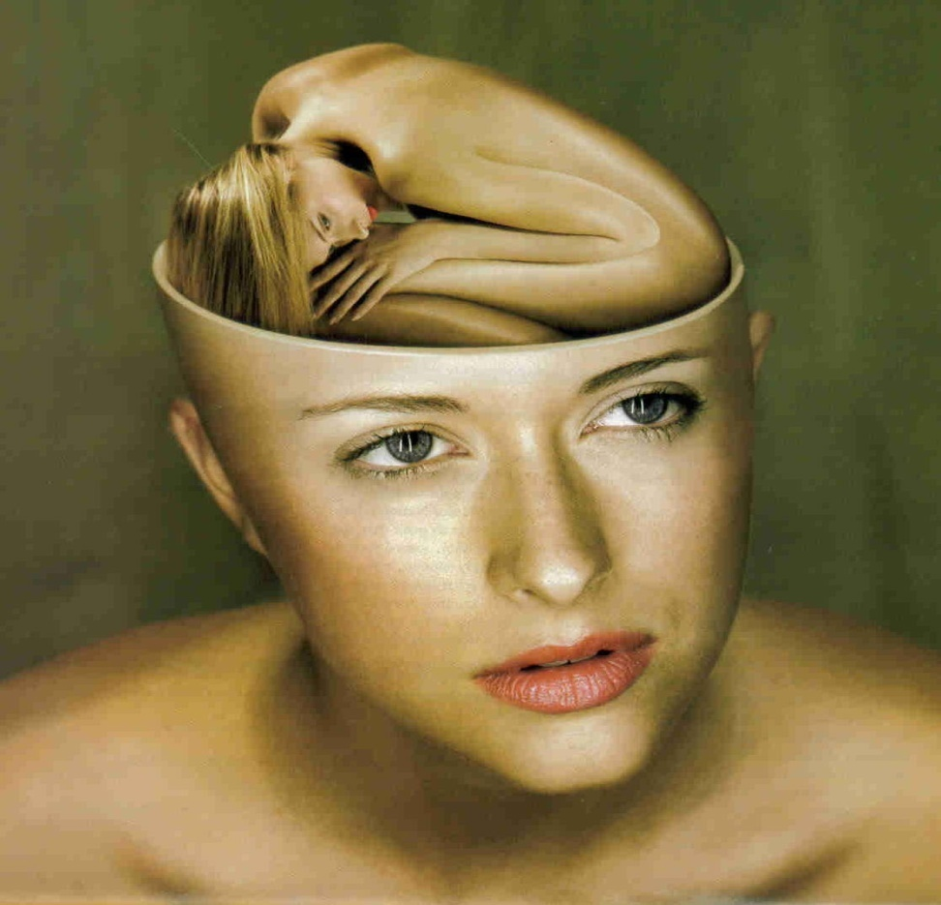
Identity Cluster
Treatment
Behavioral
Structure
Immediate reward
Medication
Neuroleptics
SSRI’s

Slide 56
Behavioral Foundation Program
TASK | MON | TU | WED | THU | FRI | SAT | SUN
SH
TX
FUN
NUT
PEX

Slide 57
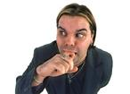
Affective Cluster
Treatment
Behavioral
Structure
Setting limits
Fair
Consistent
Available
Medications
Mood stabilizers
Antidepressants

Slide 58
Labeling Our Feelings
“We found the more mindful you are, the more activation you have in the right ventrolateral prefrontal cortex and the less activation you have in the amygdala. We also saw activation in widespread centers of the prefrontal cortex for people who are high in mindfulness. This suggests people who are more mindful bring all sorts of prefrontal resources to turn down the amygdala.”

Slide 59
Impulsive Cluster
Self-destructive behavior
A/D use
Suicidal and parasuicidal behavior
Hurt self
Dissociation
Reduce anxiety
Eating disorders

Slide 60
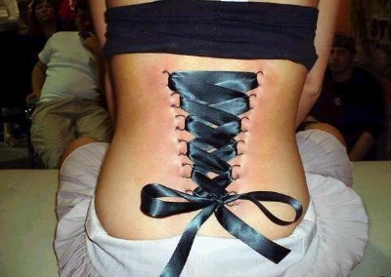
Impulsive Cluster
Assessment
Elaborate
Treatment
Contracts
Setting
Patient’s responsibility
Alternatives
Medications

Slide 61
Non-Suicidal Self Injury
What is the function of self-injury?
Did patient want to die?
Usually “No”
A way to tolerate inescapable and unbearable emotions, most often intense anxiety
Stuck in a bad situation and cannot find another way to cope
Self-injury is reinforced to the extent the behavior is effective

Slide 62
Non-Suicidal Self Injury
Self-injury is reinforced to the extent the behavior is effective (continued)
Both positive and negative reinforcement
Negative reinforcement is rewarding by making and unpleasant situation stop
Positive reinforcement is rewarding by gaining something after the behavior
When negative reinforcement generally relieves uncomfortable emotions like anger, anxiety, guilt and numbness
When positive reinforcement includes “feeling something even if it is pain”, punishing oneself and feeling relaxed

Slide 63
Non-Suicidal Self Injury
When positive reinforcement includes “feeling something even if it is pain”, punishing oneself and feeling relaxed (continued)
Males more likely to want to “make others angry”
Females more likely to want to “punish myself”
Endogenous Opioids
Hypothesized that injury induces the release of endogenous opioids which creates reward
B-endorphins comfort negative emotions (Stanley B et al, J Affec Disord 2010:124 (1-20:134-140))
Early childhood trauma changes the density of opiate receptors and level of B-endorphin baseline

Slide 64
Non-Suicidal Self Injury
Early childhood trauma changes the density of opiate receptors and level of B-endorphin baseline (continued)
May find injuring less painful and subsequent opioid release more pleasurable
Patients with only one episode of self-injurious behavior say “It hurt” and didn’t repeat behavior
Non-suicidal self injury (NSSI) may be the best predictor of suicide attempt (Wilkinson P et al, Am J Psychiatry 2011; February 1)
70% of people who engage in NSSI eventually attempt suicide

Slide 65
Behavioral Safety Plan On 3x5 Index Card
MY PERSONAL SAFETY PLAN Remember that craving go away I can write in my journal I can call my sponsor (299-289-5555) I can call my lover (299-426-1776) I can read from my favorite recovery book I can read affirmations

Slide 66
Bibliography
Perry, Bruce. Violence and Trauma: Understanding and Responding to the Effects of Violence on Young Children. Gund Foundation Publishers, Cleveland, pp 67-80, 1996.
Clinical Management of Agitation. http://www.medscape.com/viewprogram/2311_pnt.

Slide 67
Bibliography
Aggression. http://emedicine.com/med/topic3005.htm
Pincus, J and Tucker, G. Behavioral Neurology Fourth Edition.Oxford University Press, New York,2003.
Glover,Janikowski and Benshoff.”The Incidence of Incest Histories Among Clients Receiving Substance Abuse Treatment”.Journal of Counseling and Development.March/April 1995.

Slide 68
Bibliography
Van der kolk, van der Hart, and Burbridge. “Approaches to the Treatment of PTSD”. Trauma Clinic, Harvard Medical School.
Perry, Bruce.”Neurodevelopmental Factors In The ‘Cycle Of Violence’”.Child, Youth and Violence:The Search For Solutions (j osofsky, Ed.) Guilford Press, New York, pp124-148, 1997.
Pincus, Jonathan. “Base Instincts”. W.W.Norton, New York, 2001.
Kent, Sullivan and Rauch. “The Neurobiology of Fear”. Psychiatric Annals.Volume 310, No 12, 2000.
Thimble. “Psychopathology of Frontal Lobe Syndromes”.Seminars In Neurology. Vol10, No3, 1990.

Slide 69
REFERENCES
Safran JD & Muran CL. Negotiating the Therapeutic Alliance. Guilford Press, NY, 2000.
Kramer PD. Moments of Engagement. WW Norton, 1989.New York: Ballantine Books,2001.
Amen DG. Healing the Hardware of the Soul. The Free Press, 2002, pg 6.

Slide 70
REFERENCES
WITHOUT CONSCIENCE: THE DISTURBING WORLD OF THE PSYCHOPATHS AMONG US. ROBERT D. HARE. GUILFORD PRESS, 1993.
SUFFERING SOULS: THE SEARCH FOR THE ROOTS OF PSYCHOPATHY. JOHN SEABROOK IN NEW YORKER, PAGES 64-73; NOVEMBER 10, 2008.
INSIDE THE MIND OF A PSYCHOPATH. KIEHL AND BUCKHOLTZ. SCIENTIFIC AMERICAN MIND, PAGES 22-29; SEPTEMBER/OCTOBER 2010.

Slide 71
REFERENCES
Insel, Thomas. “Faulty Circuits”. Scientific American, April 2010, pgs. 44-51.

